Slide 1
Multiprocessors
Based on M. Morris Mano “Computer System Architecture”--Assist. Lecturer Ahmed Salah Hameed

Slide 2
Characteristics of Multiprocessors
A multiprocessor system is an interconnection of two or more CPUs with memory and input-output equipment.
The term "processor" in multiprocessor can mean either a central processing unit (CPU) or an input-output processor (IOP).
A single CPU + one or more IOPs is not usually a (multiprocessor system)?Why?
Multiprocessors are classified as multiple instruction stream, multiple data stream (MIMD) systems.
Based on M. Morris Mano “Computer System Architecture”--Assist. Lecturer Ahmed Salah Hameed

Slide 3
Multiprocessor and Multicomputer
Both support concurrent operations.
Computers are interconnected with each other by means of communication lines to form a computer network.
The network consists of several autonomous computers that may or may not communicate with each other.
A multiprocessor system is controlled by one operating system that provides interaction between processors and all the components of the system cooperate in the solution of a problem.
Multiprocessing (reliable system): a failure or error in one part has a limited effect on the rest of the system.
Based on M. Morris Mano “Computer System Architecture”--Assist. Lecturer Ahmed Salah Hameed

Slide 4
Multiprocessor system as parallel system
The system derives its high performance from the fact that computations can proceed in parallel in one of two ways:
Multiple independent jobs can be made to operate in parallel.
A single job can be partitioned into multiple parallel tasks.
Improving performance by decomposing a program into parallel executable tasks. (two ways)
The user can explicitly declare that certain tasks of the program be executed in parallel. (done prior to loading the program) and (with help of OS).
(more efficient) way is to provide a compiler with multiprocessor software that can automatically detect parallelism in a user's program.
What is the parallelizing compiler?
Based on M. Morris Mano “Computer System Architecture”--Assist. Lecturer Ahmed Salah Hameed

Slide 5
Multiprocessors classification
Tightly coupled or Shared- Memory System
Each processor can have its own local memory (cache memory)
A global common memory (Shared memory) that all CPUs can access.
Information shared among the CPUs by placing it in the common global memory.
Loosely Coupled: or Distributed-Memory System
Each processor element has its own private local memory.
The processors are tied together by a switching scheme designed to route information from one processor to another through a message-passing scheme.
The processors relay program and data to other processors in packets.
NOTES
Loosely coupled systems are most efficient when the interaction between tasks is minimal.
Tightly coupled systems can tolerate a higher degree of interaction between tasks.
Based on M. Morris Mano “Computer System Architecture”--Assist. Lecturer Ahmed Salah Hameed

Slide 6
Interconnection Structures
The components that form a multiprocessor system are:
CPUs,
IOPs connected to input-output devices
Memory unit that may be partitioned into a number of separate modules.
The interconnection between the components depending on:
The number of transfer paths that are available between the processors and memory in a shared memory system
The number of transfer paths that are available among the processing elements in a loosely coupled system.
Some of interconnection forms:
Time-shared common bus
Multiport memory
Crossbar switch
Multistage switching network
Hypercube system
Based on M. Morris Mano “Computer System Architecture”--Assist. Lecturer Ahmed Salah Hameed

Slide 7
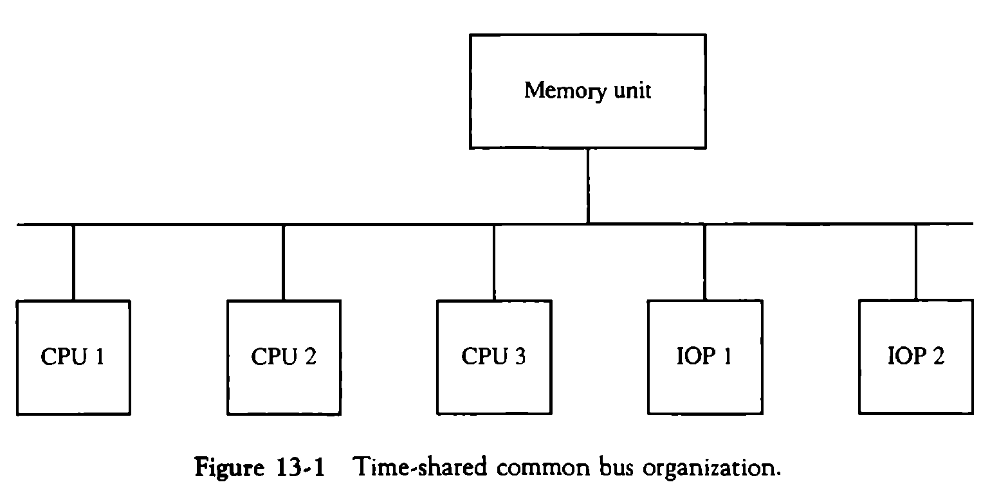
Time Shared Common Bus-a single bus structure
A number of processors connected through a common path to a memory unit.
A single common-bus system is restricted to one transfer at a time.
All other processors are either busy with internal operations or must be idle waiting for the bus.
Conflicts must be resolved by incorporating a bus controller that establishes priorities among the requesting units.
Based on M. Morris Mano “Computer System Architecture”--Assist. Lecturer Ahmed Salah Hameed

Slide 8
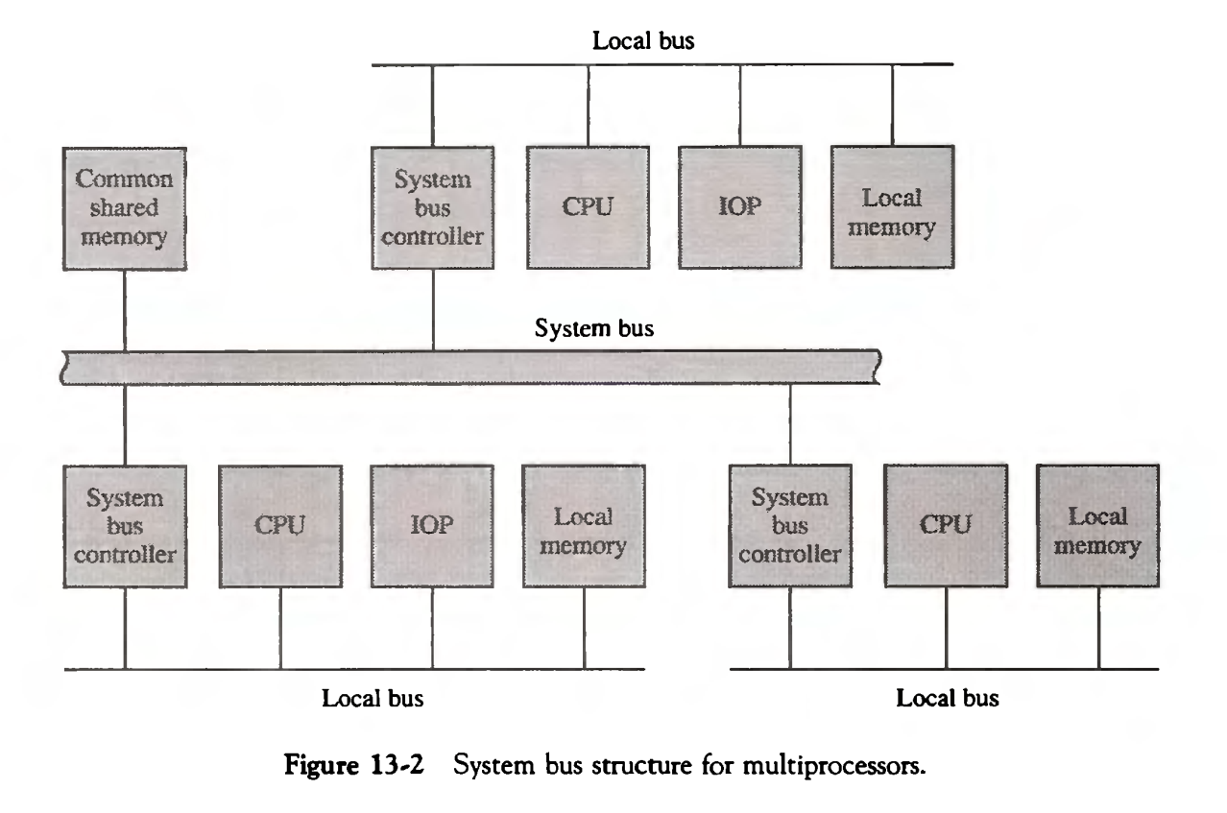
Time Shared Common Bus-a dual bus structure
Each local bus connected to its own local memory and to one or more processors.
A system bus controller links each local bus to a common system bus.
Only one processor can communicate with the shared memory and other common resources through the system bus at any given
Based on M. Morris Mano “Computer System Architecture”--Assist. Lecturer Ahmed Salah Hameed

Slide 9
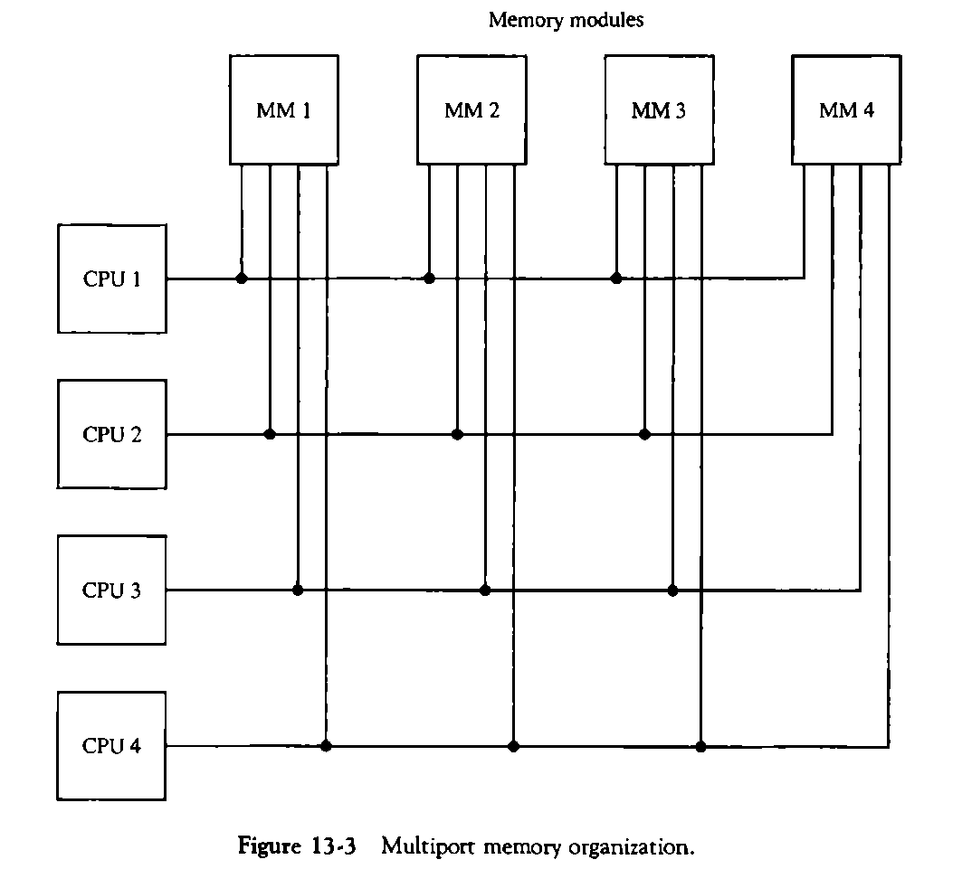
Multiport Memory
A multiport memory system employs separate buses between each memory module and each CPU.
A processor bus consists of the address, data, and control lines required to communicate with memory.
Based on M. Morris Mano “Computer System Architecture”--Assist. Lecturer Ahmed Salah Hameed

Slide 10
Multiport Memory
Memory access conflicts are resolved by assigning fixed priorities to each memory port.
Example: The physical port position as priority address:
CPU 1 will have priority over CPU 2, CPU 2 will have priority over CPU 3, and CPU 4 will have the lowest priority.
The advantage of the multiport memory organization
The high transfer rate that can be achieved because of the multiple paths between processors and memory.
The disadvantage
It requires expensive memory control logic and a large number of cables and connectors. As a consequence, this interconnection structure is usually appropriate for systems with a small number of processors.
Based on M. Morris Mano “Computer System Architecture”--Assist. Lecturer Ahmed Salah Hameed

